Slide 1

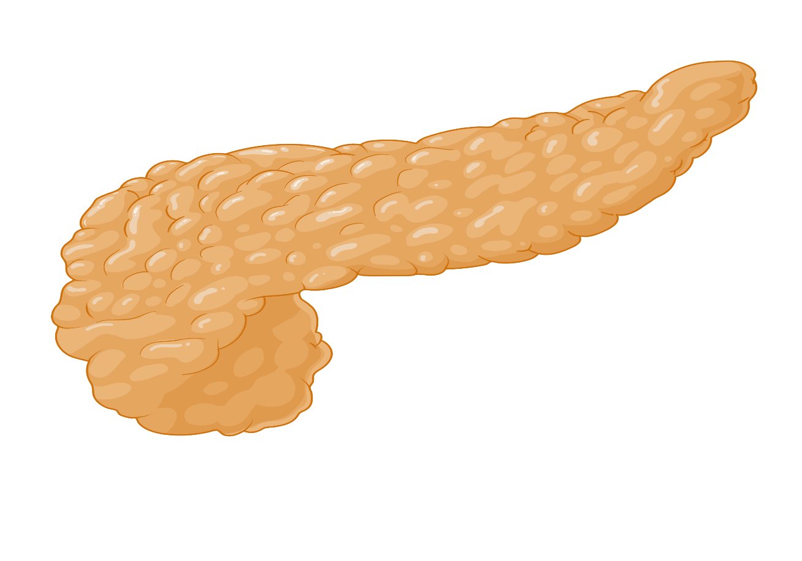
Dx & Screening
Type II Diabetes
Complications
Management
Interventions
Cases
Graphic created with BioRender.com

Slide 2

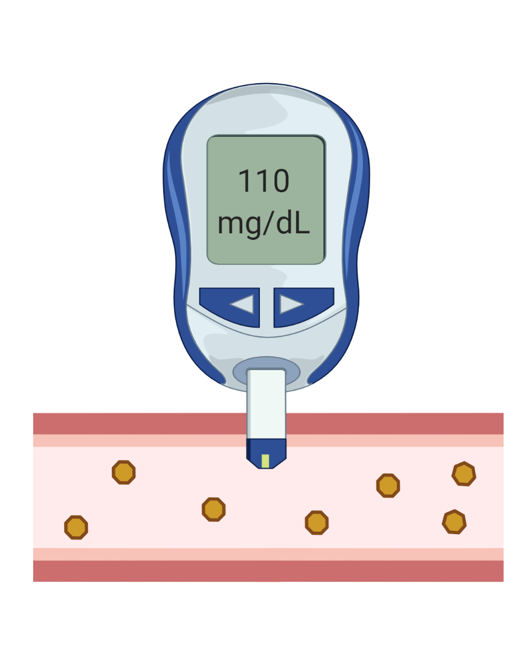

Dx & Screening
Diagnostic Criteria?
Diagnostic Criteria?
Complications
Symptoms?
Symptoms?
Weight loss
Polydipsia
Polyuria
Blurry vision
Management
yes
no
Interventions
Fasting BG > 125 mg/dL
HbA1C > 6.5%
2 occasions or tests
Random BG >200 mg/dL
Cases
Who should be screened?
Who should be screened?
Chronic steroids, antipsychotics & HIV meds
BMI >25 kg/m²
+ risk factors
History of gestational DM
History of Pre-diabetes
(HbA1C > 5.7%)
Age > 35
How frequently to screen?
Q1 year
Q3 years
Graphics from BioRender.com

Slide 3
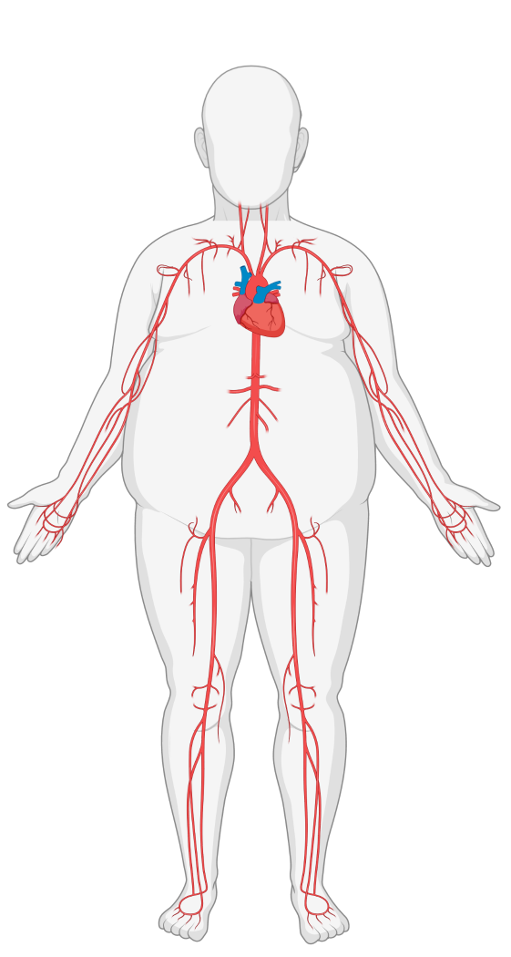
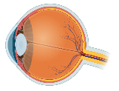

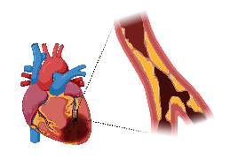
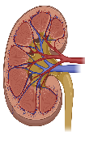


Dx & Screening
COMPLICATIONS
MACROvascular disease
Diabetes damages blood vessels
MACROvascular disease?
microvascular disease
Complications
microvascular disease?
Management
Cerebrovascular disease
Retinopathy
Retinal Scan
Interventions
CAD
Urine microalbumin / Cr
(>30mg/g)
Cases
Nephropathy
PAD
Peripheral neuropathy
Gross assessment for ulcers and nail care
Monofilament testing
Prevention
Screening
Prevention?
Screening?
Prevention
Screening
Prevention?
Screening?
Evaluate based on symptoms
Treat vascular risk factors aggressively!
BP control
Tobacco cessation
Lipid management
Yearly!
Aggressive HbA1c target of <7%
Graphics created with BioRender.com

Slide 4


Dx & Screening
MANAGEMENT
1st line for all DM
Metformin (eGFR >30)
+ Lifestyle Modifications
Complications
1st line for all DM?
Management
High risk of CVD, CKD, or HF?
Yes
No
Yes
No
Interventions
A1c not at goal?
Cases
Select treatment based on priority
CKD + albuminuria
CVD or high risk
How do you make the treatment more effective?
CKD + albuminuria
CVD or high risk
Avoid Hypoglycemia
HF
Weight loss
Avoid Hypoglycemia
HF
Weight loss
Cost
Cost
SGLT2
SGLT2 > GLP1
SGLT2 = GLP1
GLP1/ SGLT2
GLP1/ SGLT2
A1c >target
A1c >target
A1c >target
A1c >target?
A1c >target?
A1c >target?
Sulfonylurea or insulin
Sulfonylurea or insulin

Slide 5


Dx & Screening
Cardiac
Cost
PO/SQ
Wt
HF
CVD
Renal
Side Effects
A1c
Complications
Metformin
GI upset
Avoid in GFR<30
Metformin
$
PO
↔
-
?
-
↓↓
Management
Liraglutide, dulaglutide, exenatide
Semaglutide*
Thyroid ca
Pancreatitis
GI upset
Interventions
GLP-1 agonists
$$$
SQ/PO*
↓
-
↓↓
Cases
Hypotension
DKA
Amputations
Fournier’s, UTIs
Canagliflozin, dapagliflozin, empagliflozin
SGLT2 inhibitors
$$$
PO
↓
↓
Glipizide, glyburide, glimepiride
Hypoglycemia
No glyburide in CKD
Sulfonylurea
$
PO
↑
-
-
-
↓↓
Glargine, NPH, Lispro, Aspart
Insulin
$
SQ
↑
-
-
-
Hypoglycemia
↓↓↓
Diet
High relapse rates
Diet
$
-
↓
-
-
-
↓
Surgery
High relapse rates
Surgery
$$$
-
↓
-
?
-
↓↓

Slide 6
Dx & Screening
Case 1
Case 2
Case 3
Complications
Would you screen the following asymptomatic patients for diabetes?
55 yo presents to clinic to establish care. Reports 2-3 months of polydipsia and polyuria. BMI is 42.
42 yo with a history of SLE, ESRD on HD, hypertension, hyperlipidemia presents to establish care.
Meds: prednisone, erythropoietin, amlodipine, atorvastatin.
Exam: BMI 22. BP 115/74.
Labs: Fasting BG 160, HbA1c 5.6%.
Management
23 yo G1P1 F with a history of gestational DM
What additional tests would you order?
Interventions
Yes. She will need lifelong screening at least every 3 y.
BMP, Urine albumin/Cr, lipid panel. Retina + foot exam.
Cases
33 yo Asian F with BMI of 23 with a history of PCOS
Does this patient have diabetes?
What referrals are indicated?
Very likely. Confirm with a second fasting BG > 120. The A1c is discrepant and underestimates average BG with high RBC turnover (erythropoietin).
1-3
Yes. Asian Americans with BMI > 23 (vs. 25 for other ethnicities) with RFs should be screened.
Nutrition, exercise, and weight loss counseling. Then consider surgery (BMI > 40).
4-6
28 yo with schiozophrenia on olanzapine . BMI 22.
What medications would you recommend?
You confirm diagnosis of T2DM. What medications would you recommend?
Yes. Patients on certain medications (thiazides, steroids, HIV meds, atypical antipsychotics should be considered.
Metformin and insulin (A1c >10%). At follow-up, add GLP1 (obesity).
Reduced dose insulin. Metformin is contraindicated with GFR <30. Few data on SGLT2, GLP1 and oral agents in ESRD.
HbA1c is 6.4%. When should they be screened again?
What if they wanted to avoid needles?
What is your glycemic target?
Patients with borderline results should have a repeat test in 3-6 months.
Metformin, SGLT2, oral GLP1 (semaglutide), +/- sulfonylurea
A1c 6.5-7.5% in ESRD. Fasting BG/ CGM can be used when A1c is inaccurate.

Slide 7
Dx & Screening
Case 4
Case 5
Case 6
Complications
45 yo with T2DM and tobacco use presents for routine DM follow up. Meds include metformin 2000 mg ER and simvastatin.
Exam: BP 152/83, foot exam nml, BMI 24.
Labs: A1c 7.4%, Cr 1.2, Urine albumin:Cr ratio is 303 mg/g
82 yo with T2DM, COPD, HTN, CAD, diabetic CKD stage 2, BPH, and cognitive impairment presents for recurrent falls. A1c is 7.5%.
Meds: metformin 1000 mg BID, glargine 10 U qHS, lisinopril 40 mg, tamsulosin, atorvastatin 40 mg.
How would you manage the following patients’ diabetes therapies?
Management
45 yo with T2DM on metformin, PAD s/p amputation. A1c 6.5%.
Interventions
GLP1 for ASCVD regardless of A1c. Avoid SGLT2 (amputations).
How would you treat the hypertension?
Cases
What is your A1c goal?
53 yo homeless and uninsured, T2DM on metformin. CKD3. A1c 8.5%.
ACE inhibitor or ARB (given albuminuria) + lifestyle modifications
1-3
<8% given age and comorbidities,
less stringent if poor overall prognosis
What meds would you use to treat DM?
Glipizide (not glyburide given CKD). Insulin may be hard to manage.
4-6
SGLT2 to improve renal outcomes given diabetic nephropathy with albuminuria.
How will you adjust their meds?
72 yo with T2DM on metformin, prior DKA, HFrEF. A1c 8.6%.
Discontinue insulin. Consider starting SGLT2 for diabetic CKD.
What nonpharmacologic intervention would lower ACSCVD risk?
GLP1 given HFrEF. Avoid SGLT2 (DKA).
…One year later, eGFR ↓ to 20. A1c is 8.3%.
Tobacco cessation counseling
67 yo with CKD3, T2DM on metformin and SGLT2 with a femur fracture after a ground level fall. A1c 8.5%
Their A1c ↑ after losing their job. What is the next step in management?
How will you adjust their meds?
Stop metformin (GFR<30). Given worsening comorbidities, accept A1c up to 8.5%.
Stop SGLT2 (possible ↑ risk of fracture). Start GLP1 (renoprotective)
Assess social determinants of health and mental health.

Slide 8
Practice Update — ADA Standards of Care 2025–2026
• Organ-protection drugs are now a CORE strategy, independent of A1c or metformin. Start an SGLT2 inhibitor and/or GLP-1 RA with proven benefit in anyone with ASCVD (or high risk), HF, or CKD — even at A1c goal.
• Metformin is no longer mandated first for everyone; comorbidity-driven agents may be started first (metformin still reasonable, low-cost, eGFR ≥30).
• Consider INITIAL combination therapy when A1c is 1.5–2.0% above goal, or with established/high-risk CVD.
• Weight + glycemia: prefer a GLP-1 RA or dual GIP/GLP-1 RA (semaglutide, tirzepatide) for greater weight loss; useful in obesity, MASLD/MASH, HFpEF.
• HF (HFrEF and HFpEF): SGLT2 inhibitor recommended for glycemic control + fewer HF hospitalizations.
• CKD with albuminuria despite ACEi/ARB + SGLT2i: add finerenone (nonsteroidal MRA) to further reduce CKD progression and CV events.
• Screening unchanged: start at age 35 (or earlier with overweight/obesity + ≥1 risk factor).
Source: ADA Standards of Care in Diabetes 2025 & 2026 (Diabetes Care, Suppl. 1, Sections 2, 9, 10, 11).

Slide 9
Take-Home Points
• Screen for T2DM at age 35, or earlier if BMI ≥25 (≥23 in Asian Americans) plus a risk factor; every 3 yr, or yearly if prediabetes (A1c 5.7–6.4%).
• Diabetes drives microvascular (retinopathy, nephropathy, neuropathy) and macrovascular (ASCVD) disease. Screen microvascular complications yearly; tight A1c (<7%) prevents micro- but not established macrovascular disease.
• Individualize therapy by comorbidity FIRST, then A1c. ASCVD/HF/CKD → SGLT2i and/or GLP-1 RA regardless of A1c (mortality/renal benefit; insulin has none).
• Liberalize A1c to 8–8.5% in older adults with limited life expectancy or many comorbidities; avoid hypoglycemia.

Slide 10
Attribution & Optimization Notes
• Adapted from TeachIM.org "Outpatient Management of Type II Diabetes Mellitus" (Brett, Guinn, Melton, Trefilek, Fainstad; exec. ed. Zhang). Published Mar 2022, last reviewed Jun 2023.
• teachim.org/teaching_material/op-dm2/ — Licensed CC BY-NC 4.0 (attribution, non-commercial). Educational use only; clinician-reviewed.
• Surgical corrections to original deck: "duraglitude" → "dulaglutide" (slide 5); "SGTL2" → "SGLT2" ×2 (slide 4); UACR "303 mg/dL" → "303 mg/g" (case 4, slide 7).
• Added (source-cited): ADA 2025–2026 Standards of Care update slide (organ-protection as core therapy, initial combination therapy, GIP/GLP-1 dual agonists, finerenone for residual-albuminuria CKD).
• Companion files in package: Facilitator Guide (T2DM 2023), Learner Handout — Treatment Options, medication-class table.
• Optimization run: 2026-06-10. Medical content should be clinician-reviewed before teaching.

